Slide 1
E-Learning Content Development based on Emo-Inter Instructional Model for Design of Bridges according to LRFD Method
Shervan Ataei
Assistant Professor, Tel: +98-21-77240540-6102, Fax:+98-21-77451568
E-mail Address: ataei@iust.ac.ir
Atefeh Najibi
Mohammad Ali Rostaminezhad
Mohammad Ali Rostaminezhad
9908
Notes:
This paper is “E-Learning Content Development based on Emo-Inter Instructional Model for Design of Bridges according to LRFD Method” and is about how to teach engineering courses by computer through e-learning.
By Ataei (Assistant Professor), Najibi (Expert in e-learning) and Rostaminezhad (expert in teaching).

Slide 2
1. INTRODUCTION
How to design teaching materials and packages by computers for engineering courses?
Is COMPACT 1999 useful for the e-content of Concrete Bridges course?
What are Learning objects?
Is emotion has positive effect in learning?
What are the educational methods?
 | Real | Virtual
Audio | Lecture | Book, Radio
Visual | Field Trip | Movies, Television
Experimental | Laboratory | Virtual simulation
Educational methods
2
Notes:
In this paper, many efforts have been made to design teaching materials and packages by computers for engineering courses around the world such as the Computer Aided Concrete Teaching (COMPACT 1999) for the Concrete Bridges course.
Learning objects are the smallest independent educational components which can be reused in e-content of different subjects and authors; thus it is more economical and time-saving in e-content development.
"Experiments indicated the superiority of emotion aware over non-emotion-aware with a performance increase of 91%.“
Interaction between learners, learner-content, learner-teacher is crucial for increasing emotion.

Slide 3
1. INTRODUCTION
Temptation
Body (nervous- mental system)
Sense (Ear, Eye)
Cognition
External stimulus
Attention
Heart
Behavior
Emotion
Genetics
Respondent (passive) model of human
3
Notes:
In general, human behavior model could be respondent or passive;
Since the true and complete learning is obtained by the students' operant and active practice, intended cognitive-emotional-behavioral model through student learning is according to operant model.
By cognition we mean logical perception, by emotion we mean emotional feeling and by behavior we mean observable human action.

Slide 4
1. INTRODUCTION
Body (nervous- mental system)
Biological needs (individual)
Sense (Ear, Eye)
Cognition
Security (individual)
Love
(Social cooperation)
Honour
(Social competition)
Attention
Thanks God
رفتار
Heart
Behavior
Emotion
Genetics
Needs (Motivation)
Internal stimulus
Operant (motivational, active) model of human
4
Notes:
Motivations or needs of human can be categorized in some levels. The lowest level of needs is biological and security needs which are individual needs. Human and plants have this need in common. The higher levels of needs are need for love and honor which are social needs. Need for love is a cooperative need and need for honor is a competitive need. Human society covers the need for love and honor. These two needs are shared by human and animals. The highest level of needs is the need for thanking God. This need is exclusive to human.

Slide 5
2. EMOTIONAL AND INTERACTIVE INSTRUCTIONAL MODEL
Organization
Similitude
Exercise
Learning
Ranking
Inspiration
Experience
Visiting
Emotion
Belief
Confidence
Information
Cognition
Action
Learning model
5
Notes:
This Figure shows a proposed learning model. In this model, at first, information turns into cognition then to emotion next to action or behavior and finally to belief. Belief reinforces the cognition, emotion and action; and it provides learning. It paves the way for permanent changes in spirit.
In this model, the process of learning should be in accordance with the positive emotion spectrum and preferably in the form of active expression. Due to the remarkable effect of emotion on learning, special attention should be paid to emotion; especially in e-learning because of being distant and hence missing the face to face interaction.
Educational e-content should be based on emotions. Structures and components used in the development an e-content should be designed to increase emotion and it should be considered a key criterion for virtual products assessment.
To increase emotional association, similitude, examples and virtual experiences should be employed to create a mutual interaction with learners. Virtual or real visits of projects, explaining the application of theoretical subjects and creating a dynamic interaction by establishing groups, scientific associations and forums can increase the level of emotion in learning. Presenting lessons along with questions and answers with two narrators can also establish an interactive communication and increase the emotion.

Slide 6
2. EMOTIONAL AND INTERACTIVE INSTRUCTIONAL MODEL
Before Learning
A
1
Learning
2
Emotion
Cognition
3
Action
B
After Learning
6
Notes:
Based on learning model to have a complete learning, student’s coordinate should be changed in three dimensional coordinate as cognition, emotion and act.
In first step: the changes will be occurred in cognition axes by content organizing and cognitive explanation,
In second step: the changes will be occurred in emotion axes by imagination, example and view,
In third step: the changes will be occurred in act axes by practice, experience and changes, and thus complete learning will happen.
By complete learning, we can go from A to B point.

Slide 7
2. EMOTIONAL AND INTERACTIVE INSTRUCTIONAL MODEL
The percentage of the students, who found the objectives considered
Students | Percentage of agreement with aim
 | Operant model | Thanking God motivation | Emotion of learning
Graduate | 75 | 73 | 71
Undergraduate (senior) | 81 | 88 | 88
Undergraduate (junior) | 88 | 70 | 85
Mean of all | 82 | 75 | 81
Standard deviation | 24 | 35 | 29
7
Notes:
This learning model was applied in one semester for about 50 graduate and undergraduate students. According to the survey carried out on learning model, on average 79% of students evaluated the operant models of students, having motivation to thank God, and considering emotion very effective in learning.

Slide 8
2. EMOTIONAL AND INTERACTIVE INSTRUCTIONAL MODEL
Percentage of students who believe the goals of the learning model were achieved according to the designed criteria
Students | Operant model | Thanking GOD motivation | Thanking GOD motivation | Emotion of learning
 | Studying other references | Expenditure as an outcome of learning | Remembering God, who created relations | Sense of mastery of course materials
Graduate | 76 | 66 | 37 | 71
Undergraduate (senior) | 77 | 75 | 46 | 64
Undergraduate (junior) | 75 | 71 | 59 | 70
Mean of all | 76 | 70 | 48 | 69
Standard deviation | 16 | 24 | 29 | 21
8
Notes:
Also some criteria are introduced to evaluate the success of the learning model in achieving its goals. “Not solely depending on the lecture and studying other references of the course” is considered as operant criteria, “amount of remembrance of GOD and expenditure for him” is considered as the criterion to assess the motivation to thank God, and “sense of mastery of course materials” is considered as the criterion for measuring the learning emotion. It was concluded that the average realization of learning model criteria according to the survey results were as follows: operant model of students goal: 76%; thanking GOD motivation goal: 59%; emotional learning goal: 69%; (Table 3). On the average, 68% of students maintained that objectives were achieved.

Slide 9
3. DESIGN MODEL OF LEARNING OBJECTS
Preparation of original educational component (presentation file)
Preparation of the narrative letter
Providing production scenario
Reviewing and correcting the bugs in the produced files
Educational component production by contractor
Recording the course in studio
Development stages of each content objects
9
Notes:
For e-learning content development of concrete bridge superstructure design course, the following steps were taken (Fig. 6):
Preparation of original educational object presentation.
Preparation of the narration by the teacher (writing her/his speech with all details).
Providing development scenario (Providing the manual of recording process, presenting charts, tables, Images, animations, parametric simulations, etc. by teacher, assistant, manager and e-content producer).
Recording the course in studio by the first and second narrator.
Educational object development by contractor.
Reviewing and removing the bugs in the produced files (by teacher, assistant and manager).

Slide 10
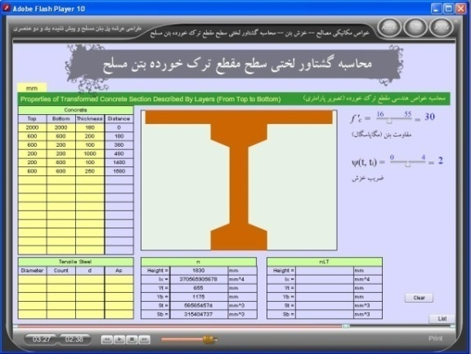
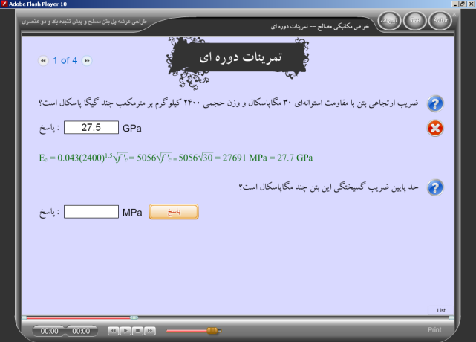
3. DESIGN MODEL OF LEARNING OBJECTS
Compressive strength of concrete
Creep coefficient
simulation of geometric properties of cracked reinforced concrete sections
Determine the module of elasticity of concrete with f’_{c}=30 MPa and γ=2400 kg/m³ according to AASHTO
What is the lower bound of module of rupture of this concrete?
10
Periodic exercise of concrete mechanical properties
Notes:
For instance, this figure presents the parametric simulation of geometric properties of cracked reinforced concrete sections in development of the e-content; the user can see the result by changing the parameters and experience learning through processing. Different kinds of exercises can be used to evaluate training processes
and the next presents periodic exercises.

Slide 11
4. CONCLUSIONS
Attention to emotional design of instruction;
Student behavior was modeled;
The proposed model is used in teaching engineering courses
Interaction with the user by virtual simulation;
on average 79% of students evaluated the learning models very useful and effective and 68% of students evaluated objectives were achieved during semester;
For e-learning content development, the following steps should be taken:
Preparation of the original narration of presentations;
Preparing the narration;
Providing development scenario;
Educational component development by the contractor;
Reviewing and revision of the object’s content.
11

Slide 12
6. REFERENCES
AASHTO, (2007). “AASHTO LRFD Bridge Design Specification” ,4th edition.
Aparicio, A.C. & Ruiz-Teran, A.M. (2007). “Tradition and Innovation in Teaching Structural Design in Civil Engineering”, Journal of professional issues in engineering education and practice, ASCE.
Astleintner, (2000) "Designing Instructional Technology from an Emotional Perspective", Journal of Research on Computing in Education.
Ataei, Sh. & Najibi, A. (2010). “Basis of E-Content production”. The Second National Conference on Modern Instructional Methods, Shahid Rajaee University, Tehran, Iran, May, (In Persian).
Barker, R.M., & Puckett, J.A., (2006). “Design of highway bridges, an LRFD Approaches” (2nd ed).
Christodoulou, S. (2004). “Educating Civil Engineering Professionals of Tomorrow”. Journal of professional issues in engineering education and practice, ASCE, pp. 90-94.
Davey-Wilson, I. E. G. (2004). “Computer-Aided Laboratory Teaching In Geotechnics”. Journal of professional issues in engineering education and practice, ASCE, Vol. 120, No. 4, pp. 430-435.
Chau, K. W. (2007), “Web-Based Interactive Computer-Aided Learning Package on Open-Channel Flow: Innovations, Challenges”, Journal of professional issues in engineering education and practice, ASCE.
Chuah, K.M., Chen, C. J., The, C.S.,(2009). “Designing a Desktop Virtual Reality-based Learning Environment with Emotional Consideration”. Proceedings of the 18th International Conference on Computers in Education, Asia-Pacific Society for Computers in Education.
COMPACT (1999), “Computer aided concrete teaching”, John Wiley & sons, http://compact.shef.ac.uk/.
Goleman, D. (2006). “Emotional Intelligence. Why It Can Matter More Than IQ” ,10th edition, Bantam.
Govindasamy, Th. (2002). “Successful implementation of e-Learning, Pedagogical considerations, Internet and Higher Education”, vol.4, pp 287–299.
Gupta, A. (2002). “Content Development for e-learning in Engineering Education”. Interactive Educational Multipedia, Number 4, pp. 12-23.
Holy Quran. “surah Al-Haj” (Ayah 36), “surah Al-Logman” (Ayah 31).
12

Slide 13
THANK YOU
13

